Slide 1
Admin info

Slide 2
Contents
What is dinner choices?
How does the administrator use dinner choices on a daily basis?
Sending dinner choices to the classes
Receiving the dinner choices
Locating individual pupils choices
Adjusting pupils choices
What are the folders?
How does the administrator setup dinner choices?
Adding/Removing classes of pupils
Adding/Removing classes
Adding/Removing individual pupils
Long term selection of a pupils choices
Setting classes out of school (I.e. not requiring lunch)
Finally
How to enable macros

Slide 3
What is Dinner Choices?

Slide 4
What is dinner choices?
Allows pupils to choose the meal they desire.
Empowers the pupils to make a choice.
Enables the canteen to produce the correct amount of each meal every day.

Slide 5
How does the administrator use dinner choices on a daily basis?

Slide 6
The following slides show what an administrator should do on a daily basis.

Slide 7
Finally

Slide 8
Finally
Please pass on any feedback/desired changes/enhancements which would make the teachers/canteen/pupils roles easier.

Slide 9
Enabling Macros

Slide 10
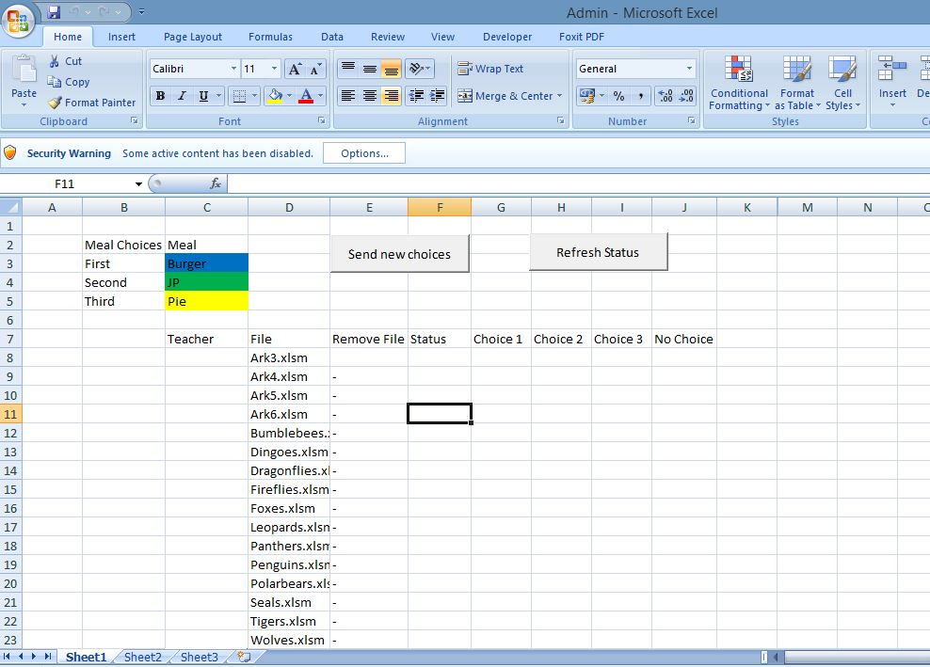
Inital warning without macros enabled
Without macros the buttons and functionality won’t be enabled

Slide 11
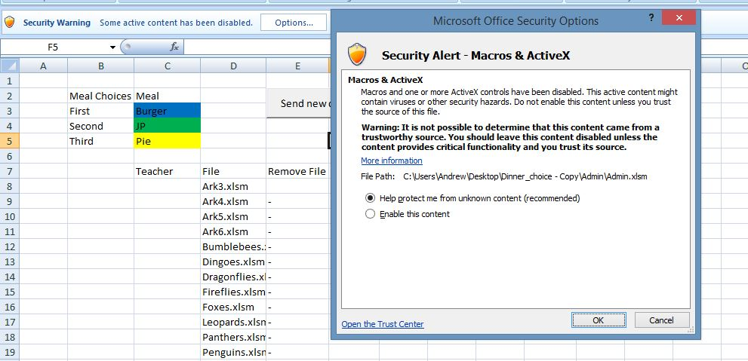
Simple enabling (not the best way)
Click on “Enable this content” and ok

Slide 12
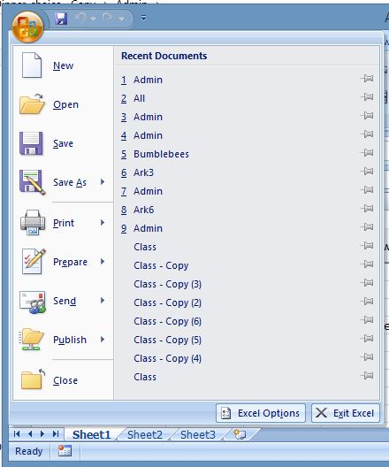
Long term you should trust the location by following these steps
Firstly click on the office button
Then open “Excel Options”

Slide 13
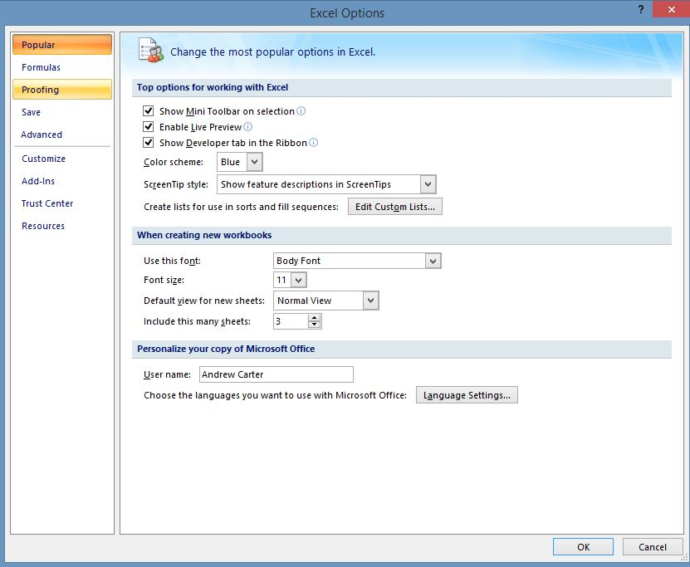
Goto Trust Center

Slide 14
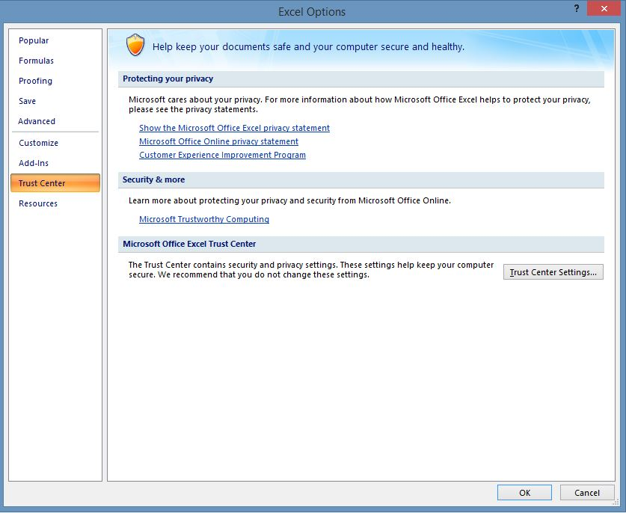
Should get you here

Slide 15
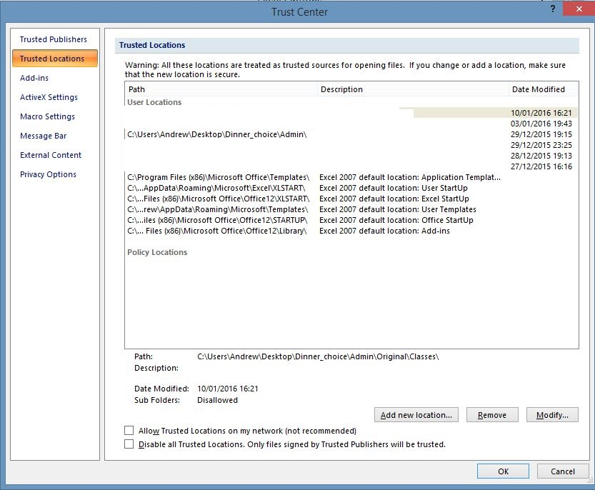
Add new location
For admin this should be the directory:
Dinner_choices\admin
I.e. Where admin.xlsm is located.

